Slide 1
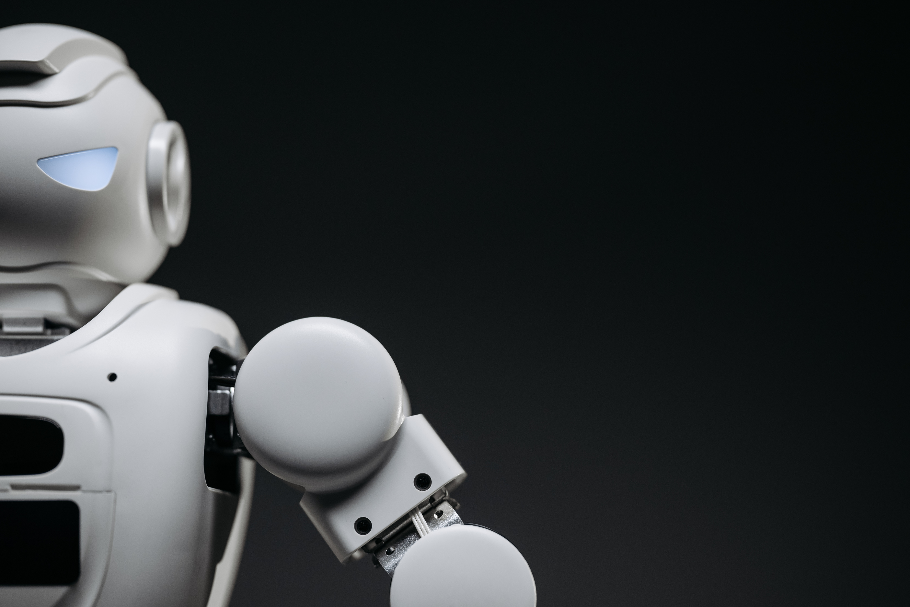
ARTIFICIAL INTELLIGENCE
NAME = MUHAMMAD SAMI ULLAH

Slide 2

INTRODUCTION
Man-made consciousness (artificial intelligence) is a part of software engineering that zeroes in on making frameworks equipped for performing errands that normally require human knowledge. These undertakings incorporate critical thinking, grasping normal language, perceiving designs, gaining as a matter of fact, and deciding

Slide 3
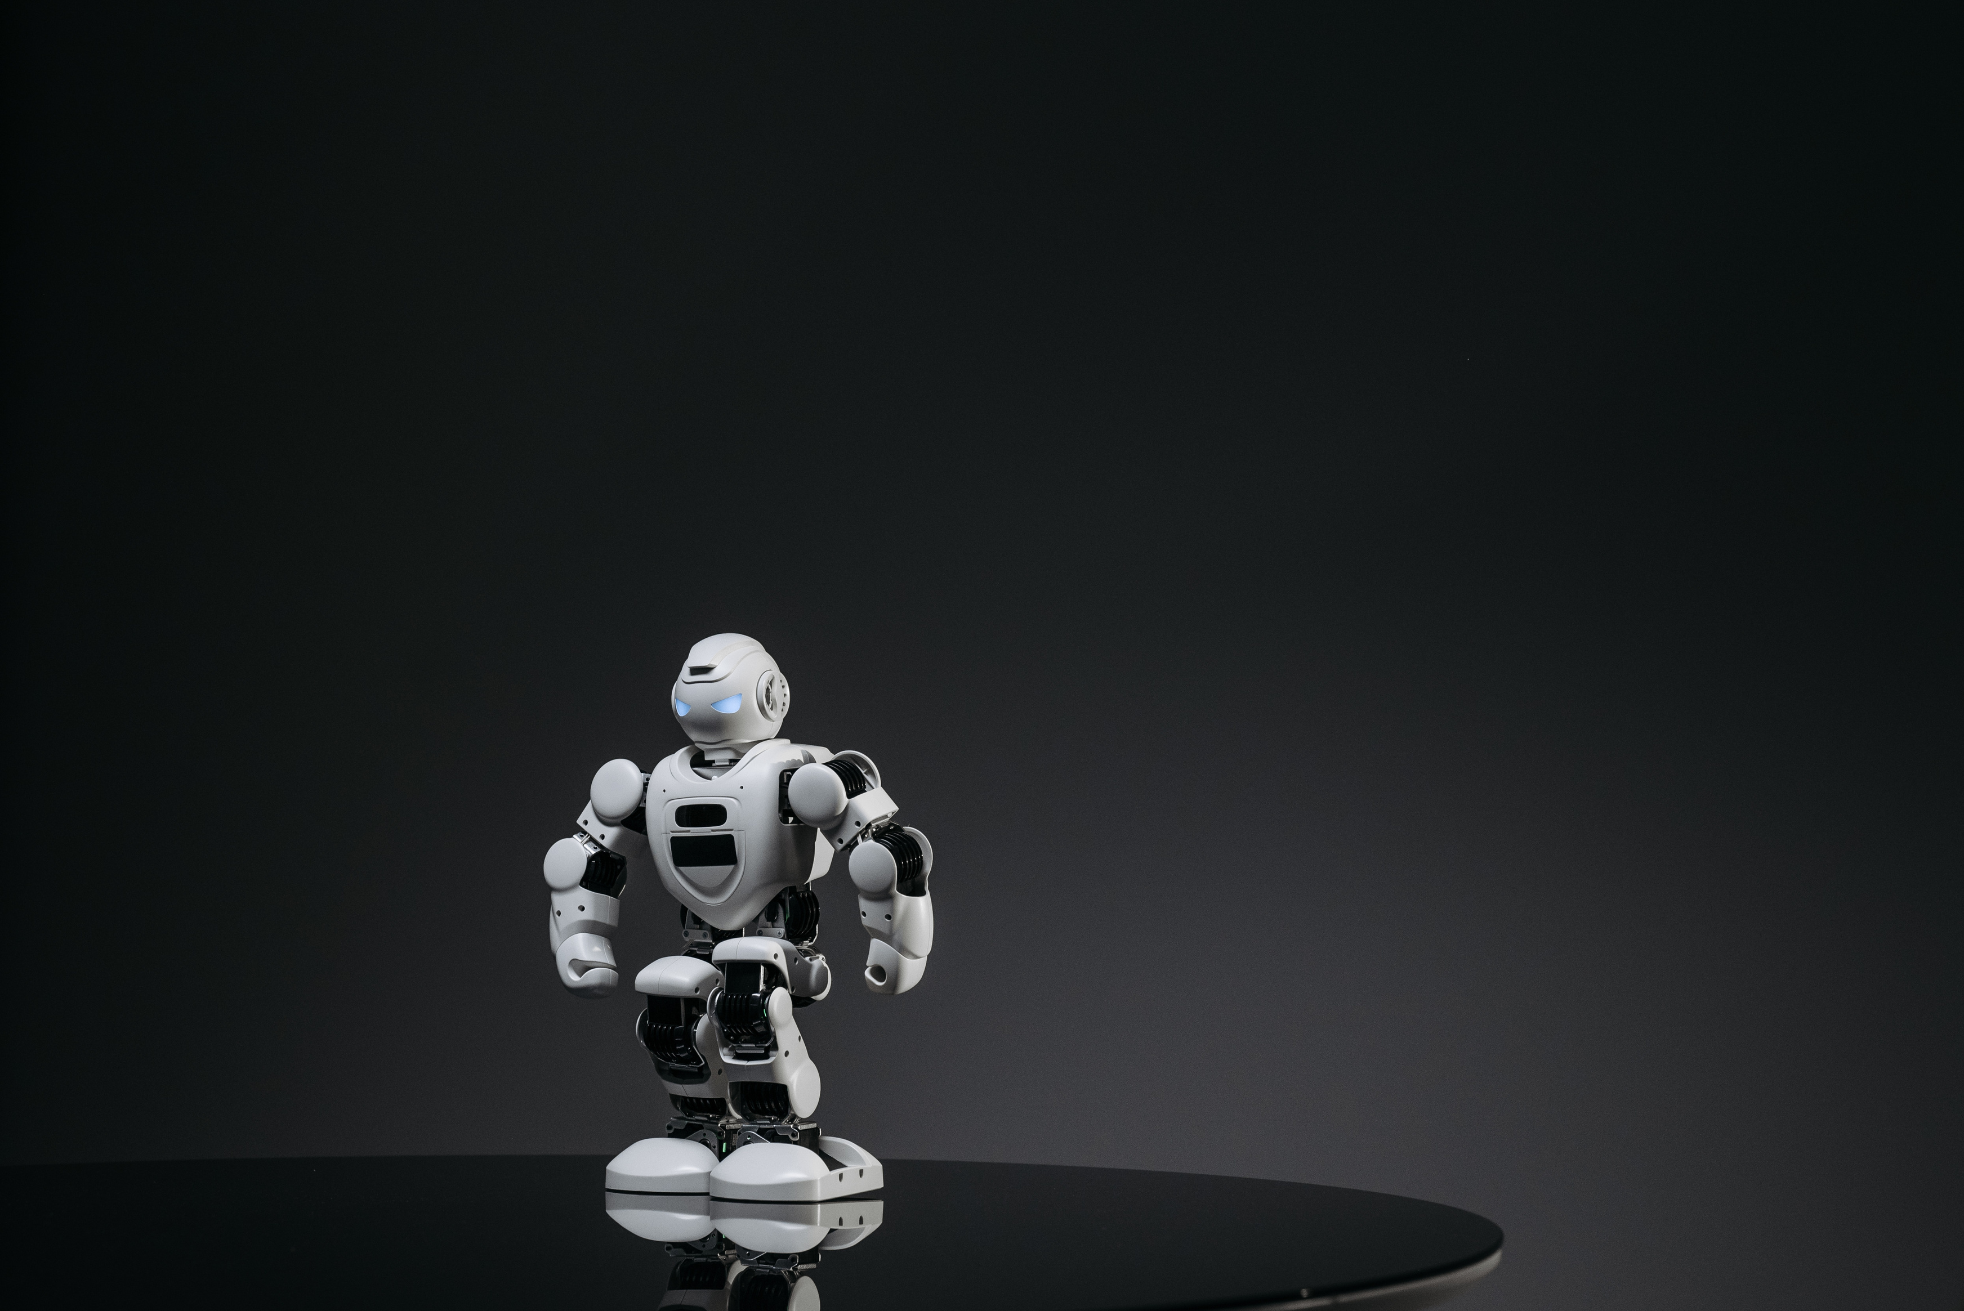
HISTORY & EVOLUTION OF ARTIFICIAL INTELLIGENCE
The set of experiences and development of Computerized reasoning (man-made intelligence) started with early philosophical and legendary ideas, developing into a conventional field during the 1950s with the primary work of Alan Turing and the Dartmouth Gathering. Early artificial intelligence endeavors zeroed in on representative thinking and brain organizations, however, constraints prompted times of stagnation known as artificial intelligence winters. The 1980s saw a resurgence with Master Frameworks, trailed by a shift to AI during the 1990s. The 2010s denoted an upset in artificial intelligence with profound getting the hang of, empowering forward leaps in picture and discourse acknowledgment. Today, simulated intelligence keeps progressing, with expanding regard for morals, cultural effects, and the quest for General computer-based intelligence.

Slide 4

TYPES OF ARTIFICIAL INTELLIGENCE
LIMITED SIMULATED INTELLIGENCE
Intended to play out a particular undertaking or a thin arrangement of errands.
GENERAL COMPUTER-BASED INTELLIGENCE
Speculative simulated intelligence with the capacity to play out any intelligent errand that a human does. It can comprehend, learn, and apply information across a large number of undertakings.
Hyper-genius simulated intelligence
A hypothetical man-made intelligence that outperforms human knowledge in all perspectives, including imagination, critical thinking, and direction. This sort of man-made intelligence is simply speculative and remains a subject of exploration and discussion.

Slide 5
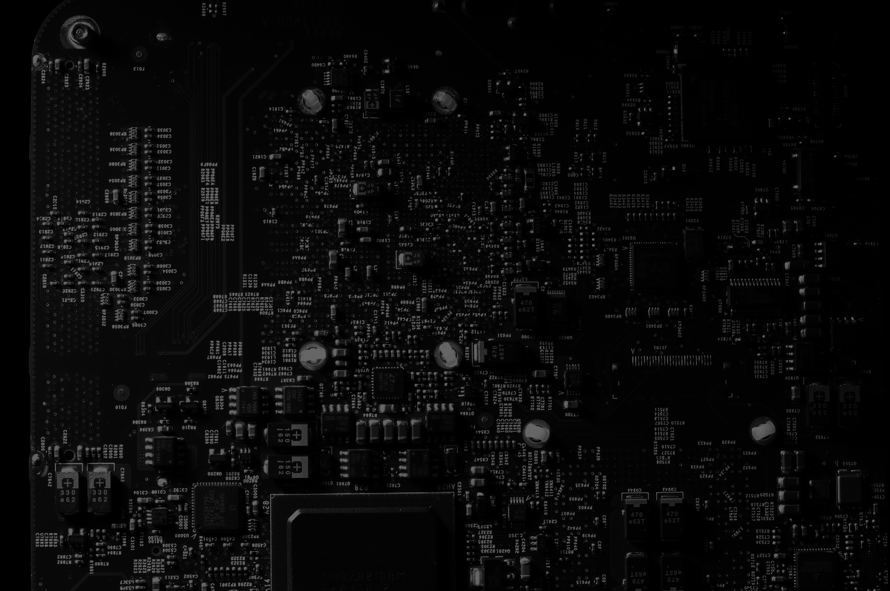

APPLICATIONS OF
ARTIFICIAL INTELLIGENCE
Medical services
Finance
Transportation
artificial intelligence can be utilized to help with computerized interchanges, offering plan updates, fitted well-being tips, and recommending subsequent stages to patients. The capacity of artificial intelligence to support well-being analysis likewise works on the speed and exactness of patient visits, prompting quicker and more customized care.
man-made intelligence assumes a crucial part in upgrading the risk of the executives in the money business. Overwhelmingly of authentic information, computer-based intelligence calculations can foresee market patterns, distinguish irregularities, and evaluate risk probabilities all the more precisely.
Alongside prescient examination, constant video checking, and different advances, simulated intelligence in transportation can track down holes in well-being and forestall more episodes out and about, inside a stockroom, and in different areas. For instance, in independent vehicles, man-made intelligence is utilized to distinguish and respond to risks quicker than a driver.

Slide 6

Ethical Considerations
01.
The rapid advancement of Artificial Intelligence brings significant benefits, but it also raises important ethical concerns. These include issues related to privacy, bias, and job displacement
SECURITY CONCERNS
Information Assortment and Reconnaissance: man-made intelligence frameworks frequently depend on immense measures of information to actually work. This can prompt worries about how information is gathered, put away, and utilized, particularly when it includes delicate individual data. Computer-based intelligence-driven advancements, for example, facial acknowledgment and virtual entertainment checking, can prompt expanded observation, possibly encroaching on people's security privileges.
ABSENCE OF STRAIGHTFORWARDNESS
Numerous simulated intelligence frameworks work as "secret elements," where the cycles and calculations utilized are not straightforward or justifiable to clients. This absence of straightforwardness can make it hard for people to know how their information is being utilized or to challenge choices made by artificial intelligence frameworks that could influence their lives.

Slide 7

ETHICAL CONSIDERATIONS
WORK REMOVAL
Robotization and Employment Cutback:
As artificial intelligence frameworks become more proficient, they progressively computerize undertakings that were recently performed by people. This can prompt huge work uprooting, especially in businesses like assembling, retail, and transportation. For example, independent vehicles could dislodge transporters, and artificial intelligence-controlled visit bots could supplant client care delegates.
Monetary Disparity
The uprooting of occupations by simulated intelligence could enlarge the hole between the people who benefit from computer-based intelligence, (for example, tech organizations and profoundly gifted laborers) and the people who are affected in a bad way, for example, laborers in low-expertise occupations. This could intensify monetary imbalance and lead to social distress if not tended to through arrangements like

Slide 8
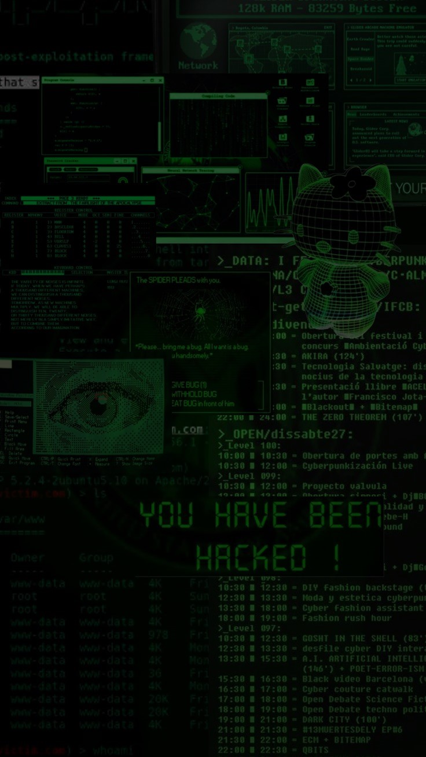
FUTURE TRENDS IN ARTIFICIAL INTELLIGENCE
HEADWAYS IN ARTIFICIAL INTELLIGENCE INNOVATION
COUNTERFEIT GENERAL INSIGHT (AGI):
While current simulated intelligence frameworks are specific (tight simulated intelligence), future improvements might prompt the production of Fake General Knowledge (AGI), which would have human-like mental capacities across a large number of errands. AGI could upset businesses by performing complex assignments that require thinking, inventiveness, and the capacity to appreciate people at their core, possibly prompting remarkable degrees of efficiency.
FURTHER DEVELOPED NORMAL LANGUAGE HANDLING (NLP)
artificial intelligence's capacity to comprehend and produce human language will keep on improving, prompting more complex menial helpers, constant language interpretation, and upgraded human-PC associations. This could change correspondence, making it simpler for individuals across the globe to associate and team up.

Slide 9
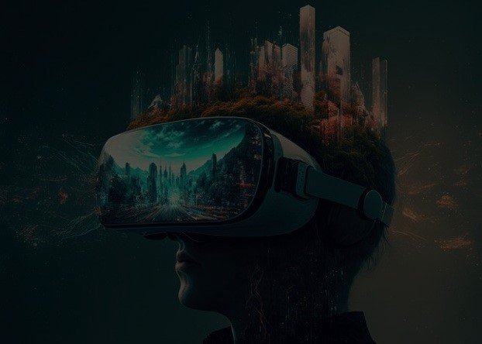
Future Trends in Artificial Intelligence
2. INFLUENCE ON THE ECONOMY AND BUSINESS
Mechanization of Perplexing Position:
As man-made intelligence frameworks become more competent, they will computerize routine undertakings as well as mind-boggling, information-based positions in regions like money, regulation, and medication. While this could prompt expanded proficiency and decreased costs, it might likewise bring about critical work uprooting across many callings, expecting society to reevaluate business and pay circulation.
Making of New Ventures
man-made intelligence-driven development could prompt the formation of totally new businesses, for example, customized medication, man-made intelligence-driven training, and independent transportation. These businesses would produce new positions and potentially open doors, however they might require an exceptionally talented labor force.
Financial Dissimilarity: The advantages of man-made intelligence could be unevenly conveyed, possibly extending the hole between the people who approach and command artificial intelligence advancements and the individuals who don't. This could worsen monetary disparities except if approaches are executed to guarantee impartial admittance to man-made intelligence's advantages.

Slide 10

Artificial Intelligence
MADE BY MUHAMMAD SAMI ULLAH

Slide 11
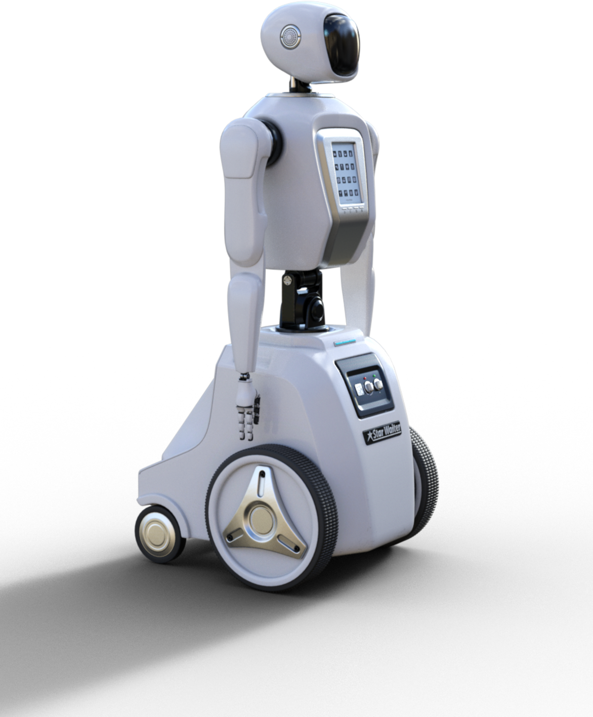
Artificial Intelligence
Thank You
FOR YOUR ATTENTION

